Slide 1
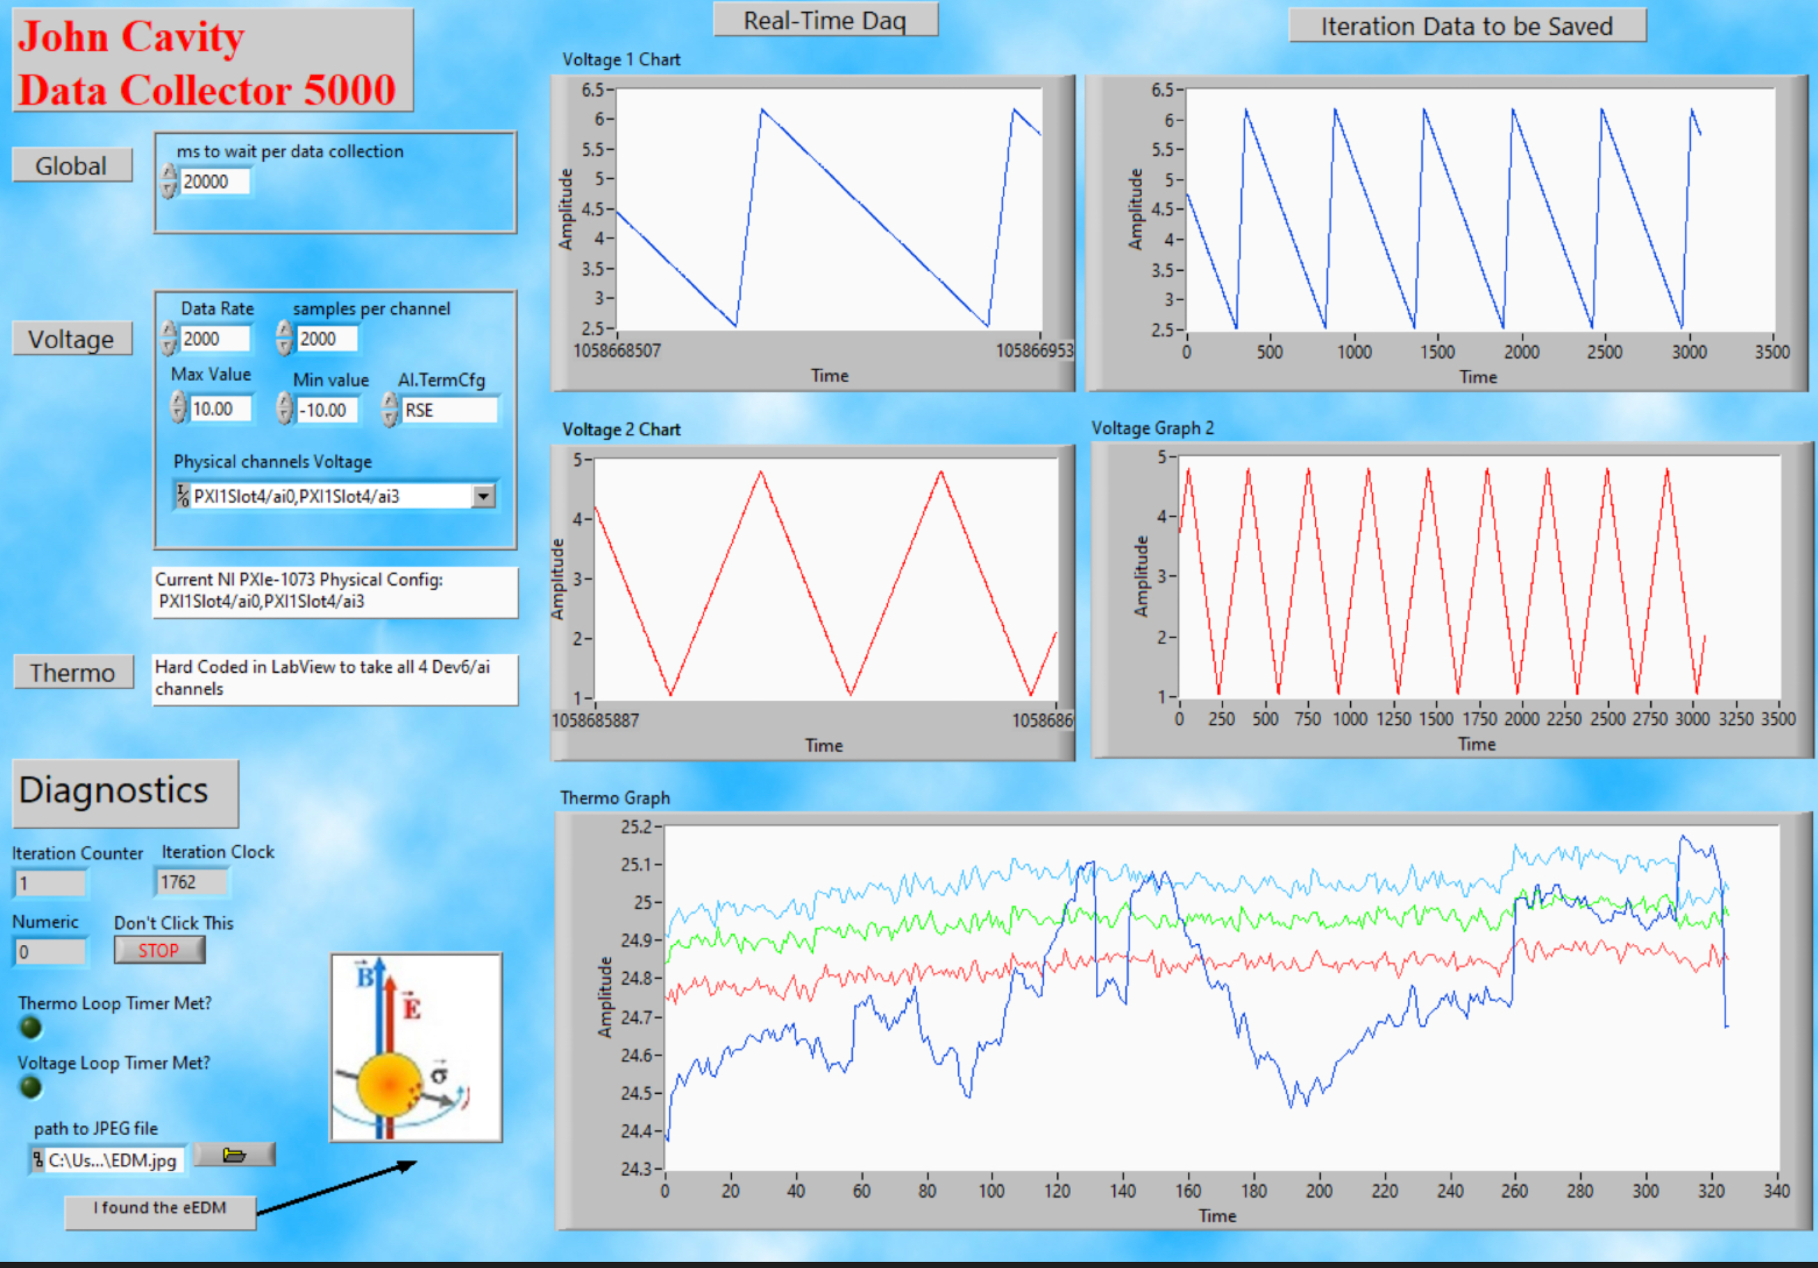
Shows DAQ output over only last few samples
DAQ output since last data collection
How often data is collected
Data rate & samples per channel
Ports on Hardware
View all four thermocouples

Slide 2
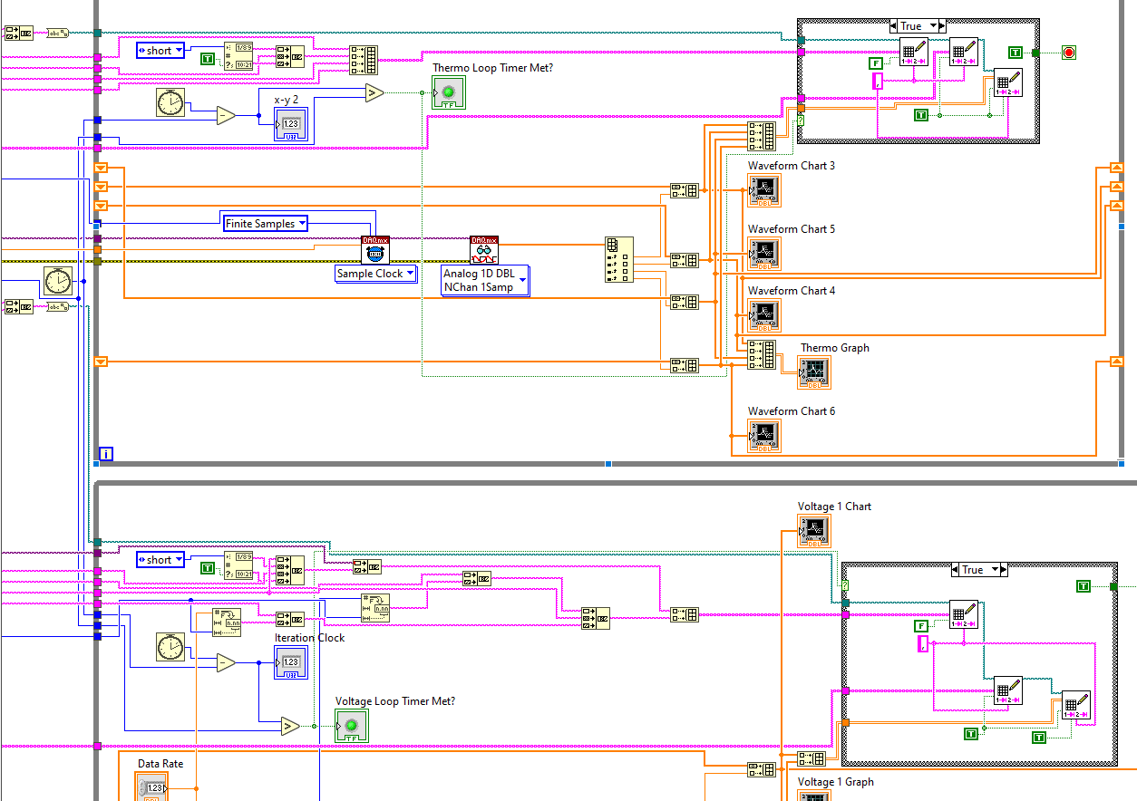

Slide 3
